Slide 1

House Buying & Selling With Price Prediction
Proposal and Feasibility Presentation
Shehzad Ahmad (SP23-BSE-088/ATD)
Abbas Khan (SP23-BSE-115/ATD)
M. Ahmad Khan (SP23-BSE-137/ATD)
Supervisor: Ahmed Ali
Department of Computer Science
COMSATS University Islamabad, Abbottabad Campus

Slide 2
Agenda of the Presentation
Motivation
Brief Introduction
Scope
Functionalities
Proposed Tools / Platform
Technical Feasibility
Financial Feasibility
Resource Feasibility
Operational Feasibility
Schedule / Gantt Chart
Tasks for 1st Iteration (30%)
Conclusion

Slide 3
Motivation
Real estate pricing in Pakistan remains highly opaque, causing buyers to overpay and sellers to underprice due to the lack of reliable data-driven insights. While platforms like Zameen.com list properties, they provide no AI-powered price validation or market trend analysis. This leaves buyers struggling with fair pricing, neighborhood assessment, and mortgage planning, while sellers lack guidance on optimal pricing strategies, listing timing, and value-adding improvements. Our solution empowers middle-income families with data-backed decisions, reduces fraud and mispricing in Pakistan’s trillion-rupee real estate market, and creates a centralized smart platform for buyers, sellers, and agents—ultimately supporting the country’s digitalization agenda through AI-driven property transactions.

Slide 4
Brief Introduction
This AI-powered real estate platform for Pakistan combines a full property marketplace with machine learning price prediction. It helps users buy, sell, or rent properties by providing fair market value estimates based on location, area, property type, and historical data. The platform includes an interactive marketplace with map integration, personalized property recommendations for buyers, and pricing and timing advice for sellers. A mortgage calculator connects to bank interest rate APIs to show monthly installments, while a 24/7 AI chatbot guides users on search, pricing, mortgages, and transactions. Market heatmaps visualize price trends, demand-supply dynamics, and livability scores. Designed for web (React.js) and mobile (Flutter for iOS and Android), the platform is inspired by Zameen.com but enhanced with real-time analytics and bilingual support in English and Urdu. It aims to make property transactions smarter, faster, and more transparent across Pakistan.

Slide 5
Scope
Web Application (React.js / Next.js) and Mobile Application (Flutter — iOS & Android)
Users receive a predicted fair market value for any property with a confidence score and an overpriced/underpriced verdict based on location, area, type, bedrooms, and historical data.
Users can search and filter properties by city, price range, area, bedrooms, and property type with an interactive Google Maps view and nearby amenities.
Sellers and agents can add, edit, and delete property listings with photo/video uploads, location pinning, and performance analytics.
Buyers receive property suggestions based on preferences and history. Sellers receive optimal listing price, best time to sell, and improvement suggestions.
Users can save favorites, submit inquiries, schedule site visits or virtual tours, and chat with sellers or agents directly. Users can estimate monthly installments and loan eligibility using live bank interest rate APIs.
The system displays area-level price trends, demand vs. supply charts, and livability scores by locality.
A 24/7 chatbot guides users through property search, price estimation, mortgage queries, and the buying/selling process.

Slide 6
Scope Cont…
Users receive price drop alerts, new listing alerts, mortgage rate changes, and appointment reminders.
Role-based logins for Buyer, Seller, Agent, and Admin with email/phone verification and profile badges.
Admins can approve or reject listings, manage users, block spam, and monitor platform-wide statistics.
Multilingual support — English and Urdu for wider accessibility across Pakistan.

Slide 7
Functionalities
. Property Search & Discovery
Filter by location, price, area, type, bedrooms; map view; nearby amenities
. AI-Based Price Prediction
ML model with confidence score; over/underpriced detection; price history
. AI Recommendations
Buyer: personalized suggestions | Seller: optimal price, timing, improvement tips
. Listing Management
Add/edit/delete listings; upload media; view analytics (views, leads)
. Buying & Renting Module
Favorites, inquiries, virtual tours, site visits, direct chat
. Dashboard & Analytics
Role-based dashboards — leads, price comparisons, trends, statistics
. Alerts & Notifications
Price drop alerts, new listings, mortgage alerts, appointment reminders
. Mortgage & Finance Calculator
Monthly installment estimates via bank interest rate APIs
. AI Chatbot Assistant
24/7 guidance on search, pricing, mortgage, and transactions
. Legal & Document Support, Market Heatmaps, Admin Panel
Doc upload/verification; heatmaps; listing approvals; admin controls

Slide 8
Proposed Tools / Platform
Category | Technologies & Tools
Frontend (Web) | React.js / Next.js, Tailwind CSS, Google Maps API
Mobile Application | Flutter (iOS & Android), Firebase Push Notifications, Dart
Backend | Node.js + Express.js, REST API, JWT Auth, Socket.io
AI / Machine Learning | Python, Scikit-learn / XGBoost, TensorFlow, Pandas, Flask (ML microservice)
Database | MongoDB, Firebase Firestore
DevOps & Hosting | AWS / Google Cloud, Docker, GitHub, CI/CD Pipeline
Development Tools | VS Code, Postman, Figma, Google Colab

Slide 9
Feasibility: Technical
AI & Machine Learning:
FEASIBLE — Mature frameworks (Scikit-learn, XGBoost, TensorFlow); public Pakistan datasets on Kaggle; team has ML background.
Web Frontend (React.js):
FEASIBLE — Widely adopted framework; team experienced in JavaScript/TypeScript; Maps API well-documented.
Mobile App (Flutter):
FEASIBLE — Single Dart codebase for iOS & Android; Firebase provides ready-made auth and notifications.
Backend & Database (Node.js + MongoDB):
FEASIBLE — Lightweight, scalable stack; MongoDB handles varied property data.
Third-Party APIs:
MODERATE — Maps API free tier

Slide 10
Feasibility: Financial
Cloud hosting platforms such as AWS or Google Cloud free-tier services will be used for deployment and testing.
Google Maps API will support location-based property search and map integration.
Open-source AI/ML libraries including Python, Scikit-learn, TensorFlow, and Pandas will be utilized for model development.
React.js, Flutter, Node.js, and MongoDB will be used as the primary development technologies.
Google Colab and GitHub will assist in ML training, collaboration, and version control.

Slide 11
Feasibility: Resource
Human Resources: 3 devs (frontend, backend, ML, mobile) + faculty supervisor + campus facilities
Hardware: Team laptops, Android/iOS test phones, university server access
Software: React.js, Flutter, Node.js, Python, MongoDB, VS Code, Git, Google Colab (free GPU)
Data: Pakistan real estate datasets (Kaggle, public listings) + synthetic data
Feasibility: All resources available — project is feasible

Slide 12
Feasibility: Operational
User Acceptance: Familiar UX (like Zameen.com) + bilingual (English/Urdu) → easy adoption across Pakistan
System Usability: Responsive web + native mobile apps + role-based dashboards (buyers, sellers, agents, admins)
Scalability: Microservices + AWS/GCP auto-scaling → cost‑effective for student deployment
Maintainability: CI/CD pipeline + modular codebase → quick fixes and easy onboarding
Stakeholder Benefit: Buyers get fair pricing, sellers get optimal strategy, agents get more leads, admins get full oversight
Feasibility: High operational acceptance — benefits are clear for all stakeholders

Slide 13
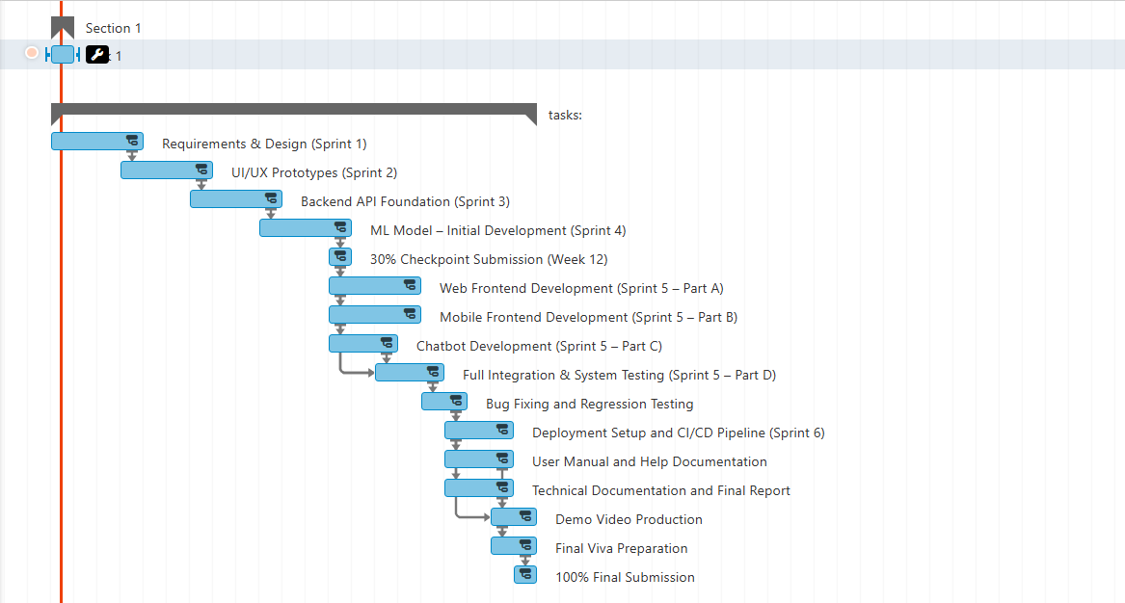
Project Schedule: Gantt Chart

Slide 14
Tasks for 1st Iteration (30% Milestone)
Deliverables for the 30% evaluation checkpoint:
Requirements & System Design
Finalized SRS document
UML diagrams: use case, activity, and sequence
ER diagram for the database schema
3-tier architecture diagram (Frontend, Backend, ML service)
UI/UX Wireframes & Prototypes
Figma mockups for major screens (Home, Search, Listing, Dashboard, Chatbot)
Navigation flow diagrams for buyer and seller journeys
Responsive layouts for both mobile and web
Backend API Foundation
Node.js + Express server with MongoDB connected
JWT authentication (register, login, role-based access)
Core REST API endpoints: CRUD for property listings
ML Model – Initial Version (In Progress)
Pakistan real estate dataset collected and preprocessed
Baseline model (Linear Regression / Random Forest) trained and evaluated
Flask API endpoint for price prediction deployed

Slide 15
Conclusion
Pakistan’s PKR 1 Trillion real estate market remains fragmented and data-blind. We're changing that with a fully feasible, AI-powered platform — featuring ML-driven price prediction, a complete buy-sell-rent marketplace, bilingual web/mobile access, and full documentation. This is not just a final year project — it’s the solution Pakistan’s property market needs.
Thank You

